Slide 1
ISONE OSW Analysis
Last updated: 9/6/2023 by Jack Ruzekowicz

Slide 2
Notebook 1: Winter OSW Analysis

Slide 3
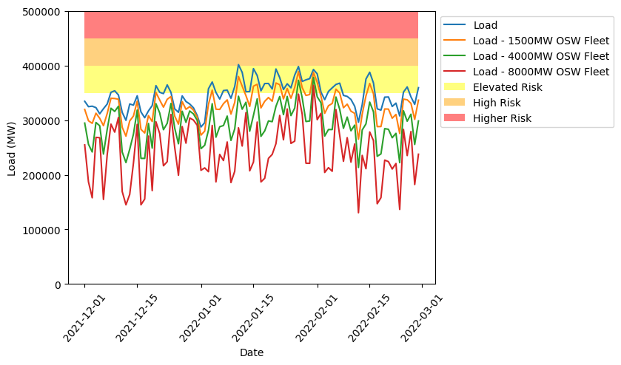
Winter 2021-2022 Load and Loads after Theoretical OSW Fleets

Slide 4
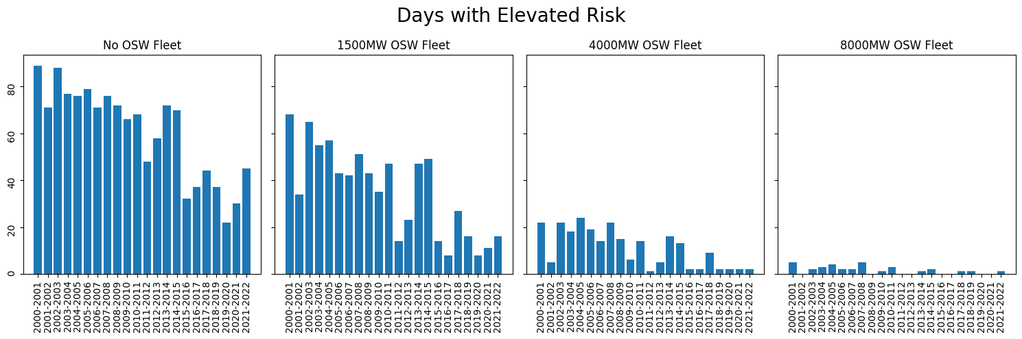
Days of Elevated Risk with Varying MWs of OSW for Winters 2000 to 2022

Slide 5
Notebook 2:
Non-winter OSW Analysis

Slide 6
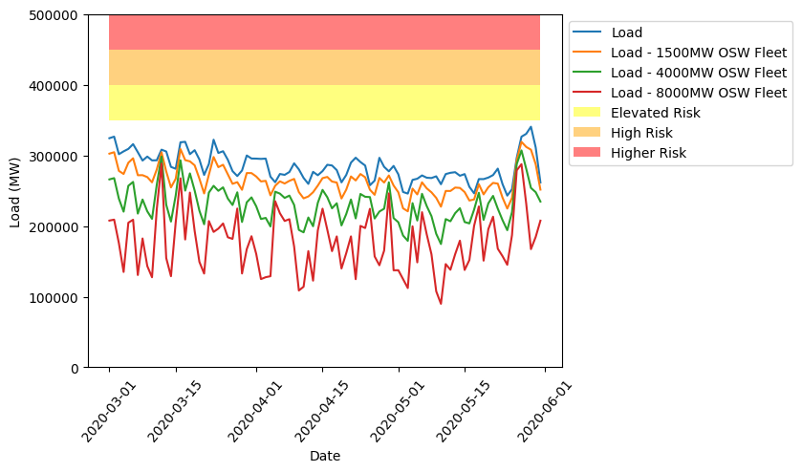
Spring 2020 Load and Loads after Theoretical OSW Fleets

Slide 7
Days of Elevated Risk with Varying MWs of OSW for Spring Months 2000 to 2022

Slide 8
Notebook 3: Winter OSW + Solar Analysis

Slide 9
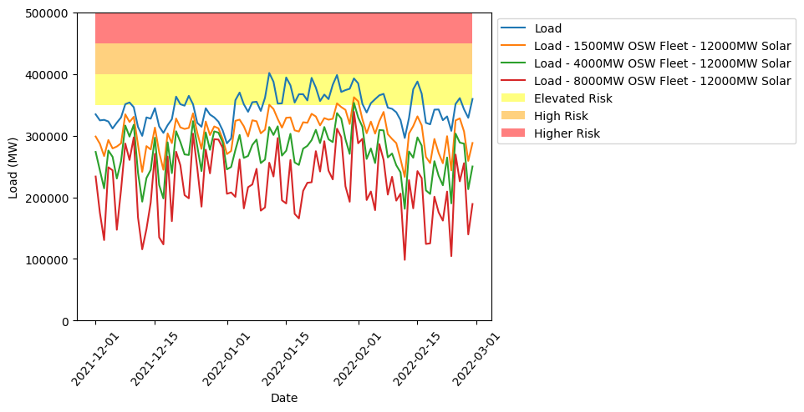
Winter 2021-2022 Load and Loads after Theoretical OSW and 12000 MW Solar Fleets

Slide 10
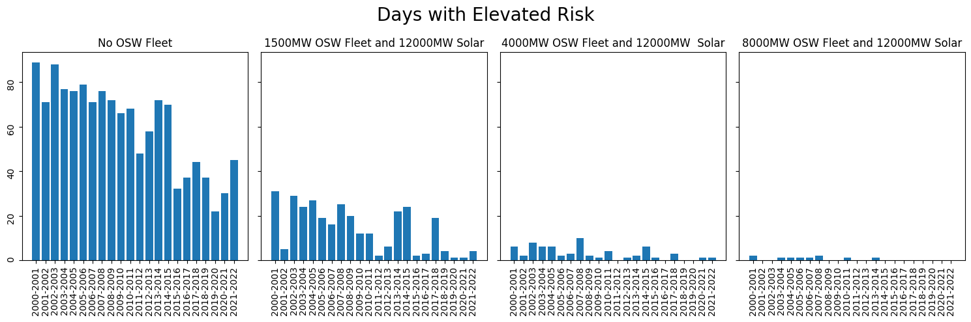
Days of Elevated Risk with Varying MWs of OSW + 12000 MW Solar for Winters 2000 to 2022

Slide 11
Notebook 4: Winter OSW + Solar Heatmaps by Year

Slide 12
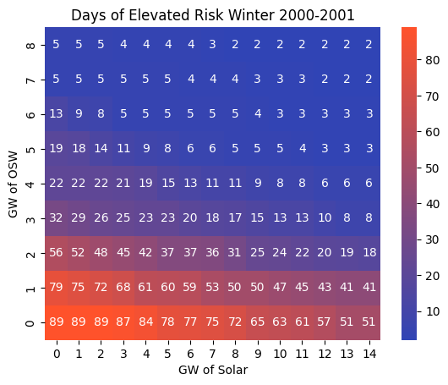
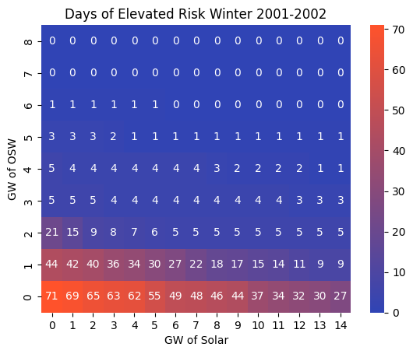

Slide 13
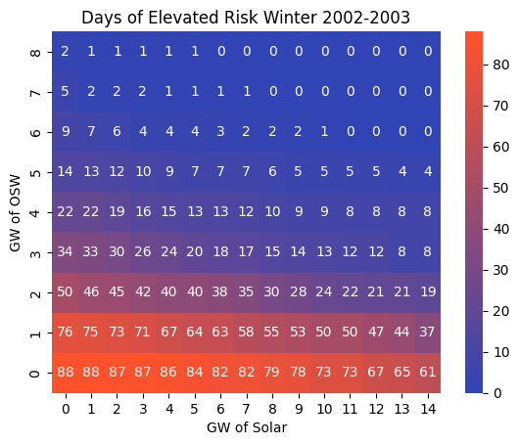
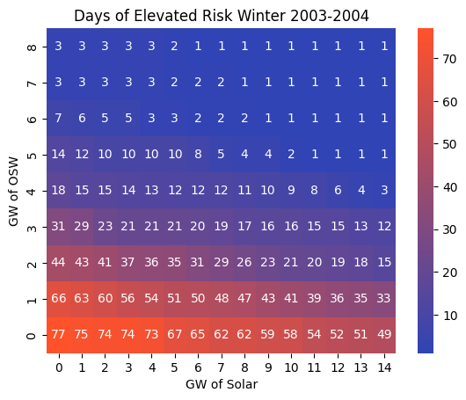

Slide 14
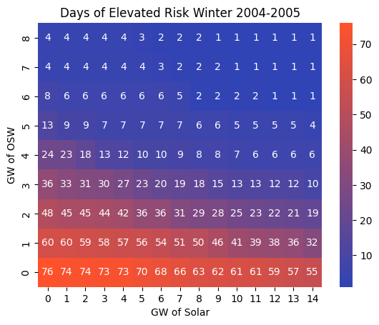
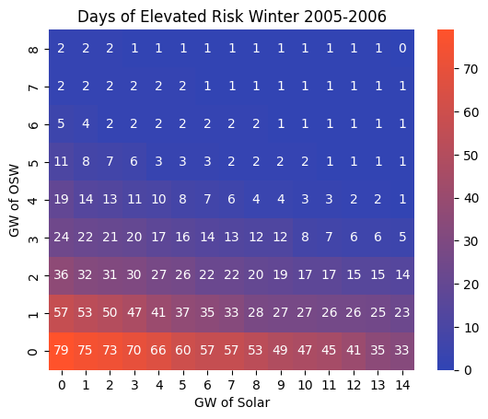

Slide 15
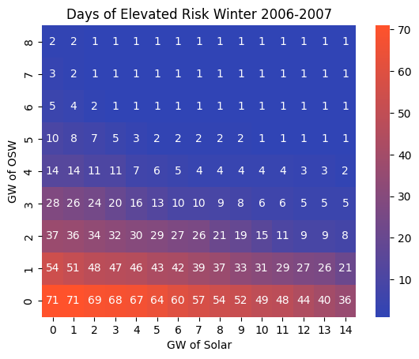


Slide 16
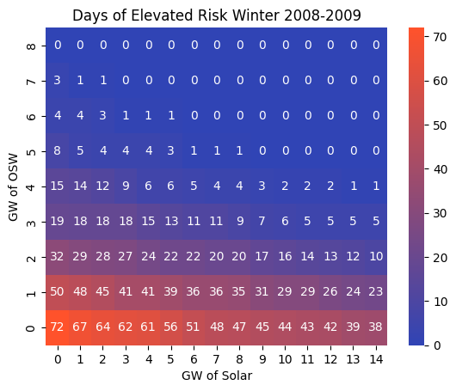
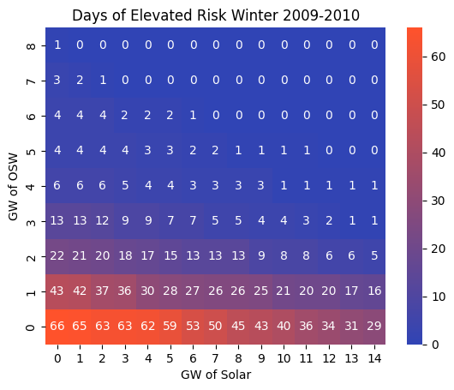

Slide 17
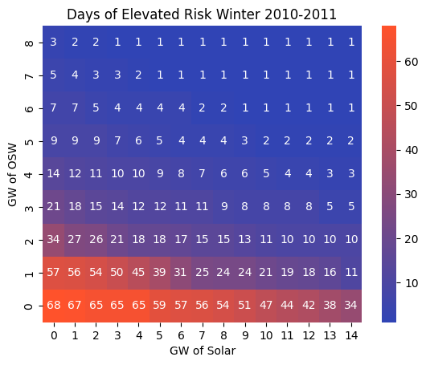
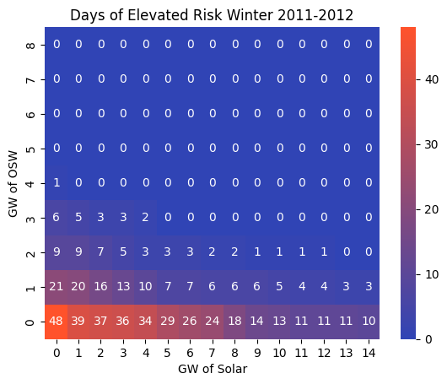

Slide 18
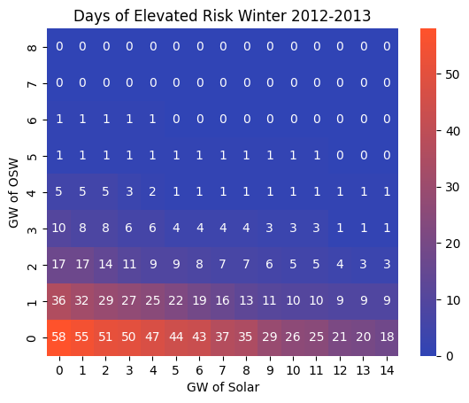


Slide 19
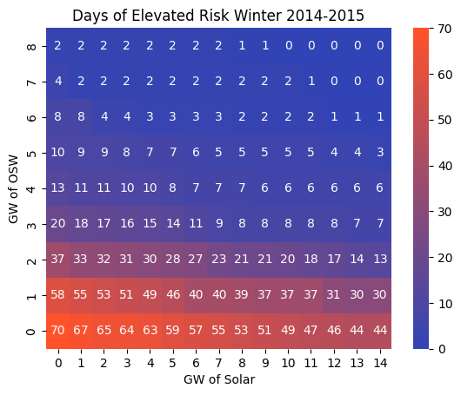
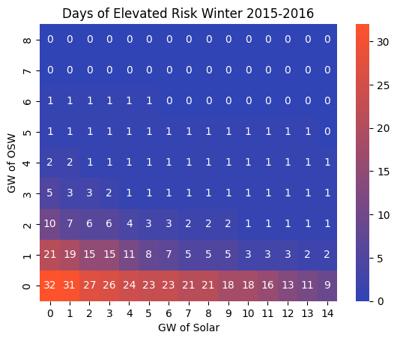

Slide 20
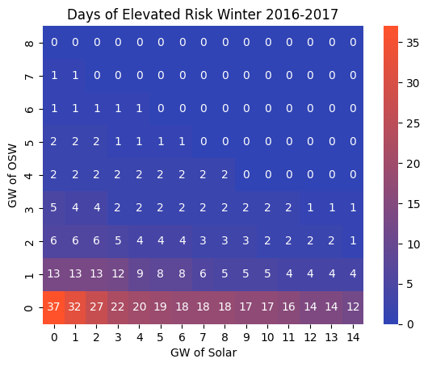
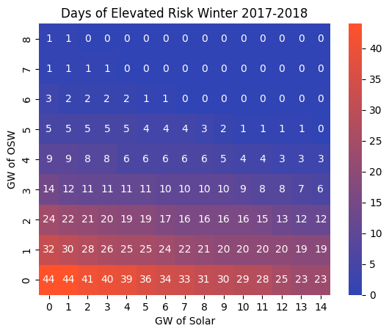

Slide 21
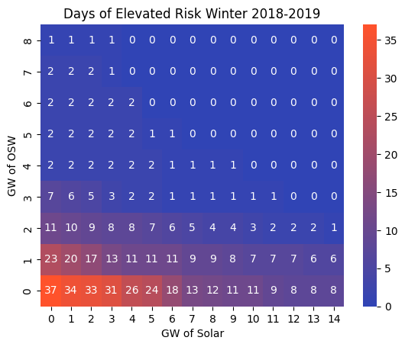
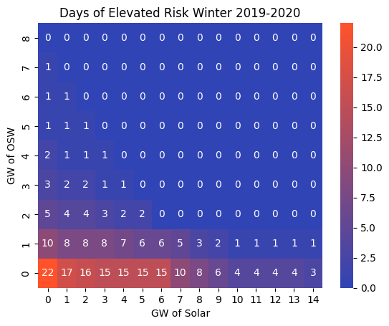

Slide 22

